Slide 1
MAX-DOAS and MWR daily report
2018 .11. 06

Slide 2
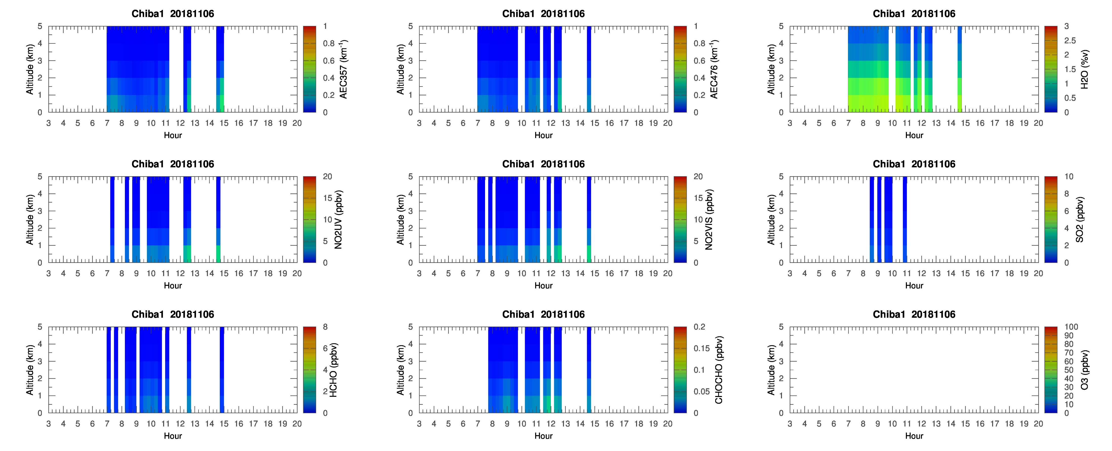
max_chiba1_20181106_ddm1

Slide 3
max_chiba1_20181106_dem1

Slide 4
max_chiba2_20181106_ddm1

Slide 5
max_chiba2_20181106_dem1

Slide 6
max_chiba3_20181106_ddm1

Slide 7
max_chiba3_20181106_dem1

Slide 8
max_chiba4_20181106_ddm1

Slide 9
max_chiba4_20181106_dem1

Slide 10
mwrchiba20181106

